Slide 1
MALIGNANT COMMENT CLASSIFIER
Submitted by: Anita Thapa

Slide 2
PROBLEM STATEMENT
The proliferation of social media enables people to express their opinions widely online. However, at the same time, this has resulted in the emergence of conflict and hate, making online environments uninviting for users. Although researchers have found that hate is a problem across multiple platforms, there is a lack of models for online hate detection. Social media platforms are the most prominent grounds for such toxic behavior.
Our goal is to build a prototype of online hate and abuse comment classifier which can used to classify hate and offensive comments so that it can be controlled and restricted from spreading hatred and cyberbullying.

Slide 3
DATA- DESCRIPTION
Data is loaded using pandas and then using dataframe data is converted into rows and columns and is named df.
Dataset is a Classification supervised learning model.
Training Dataset has 159571 Rows and 8 Columns. 7 column are numeric and 1 column is object type.
Test Dataset has 159571 Rows and 2 Columns. 1 numeric and 1 object type.
Target columns are ‘malignant’, ’highly_malignant’, ’rude’, ’loathe’, ’threat’ and ‘abuse’ . Feature column is ‘comment_text’.

Slide 4
DATA CLEANING
Dropped ‘id’ column as it is not related to target label.
Removed punctuations, emoji’s, numeric values and also lowercase all the data available in comment_text column from Training and Train dataset.

Slide 5
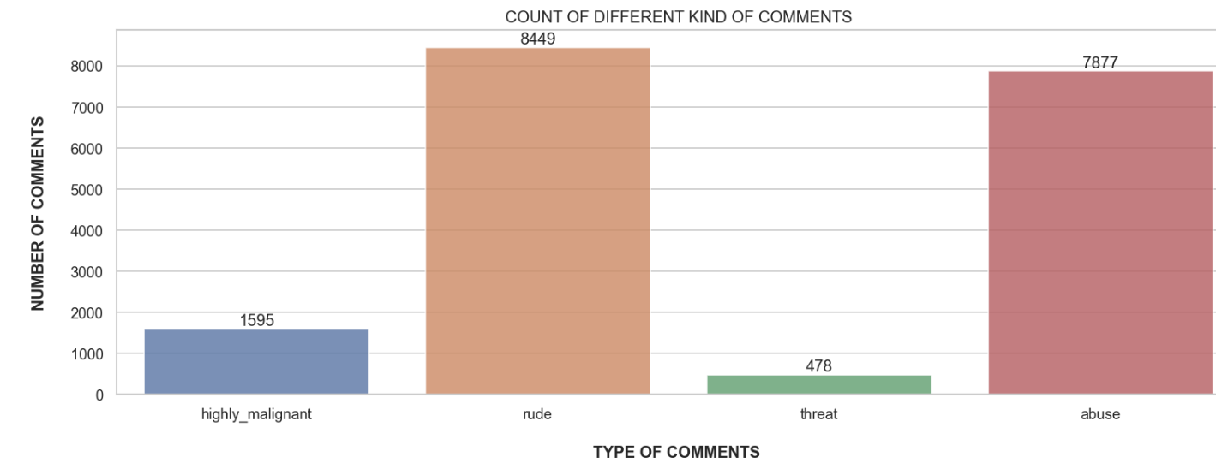
EDA : EXPLORATORY DATA ANALYSIS
Plotting:
As the data is a classification model so the comment_text column is balanced.
Plotting of target column:

Slide 6
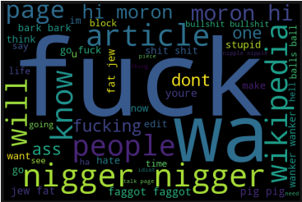
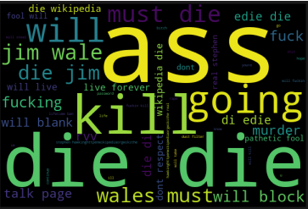
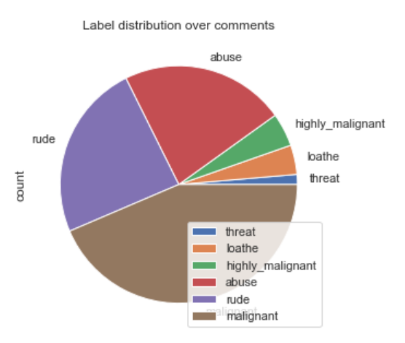
Using WordCloud target columns were plotted:
Distribution Plot of Target column:

Slide 7
MODEL BUILDING
Tfidf Vectorizer is imported along with other libraries for target columns ‘malignant’, ’highly_malignant’, ’rude’, ’loathe’, ’threat’ and ‘abuse’ and it is changed to test_data having value 0 and 1.
Importing Logistic regression and sklearn metrics library. Using train and test split library to train and test the dataset.
The dataset is of Classification Model so using the logistic regression and other classification algorithm.

Slide 8
MODEL EVALUATION
As it is a Classification problem so Logistic Regression is used along with other algorithms which are:
K-Neighbors Classifier : Accuracy and Cross validation score are 92.2% and 95.3% .
ADA Boost Classifier : Accuracy and Cross validation score are 92.3% and 92.2% .
Random Forest Classifier : Accuracy and Cross validation score are 95.6% and 95.5%.
XG-Boost Classifier : Accuracy and Cross validation score are 96.1% and 95.3% .

Slide 9
BEST MODEL
Out of all the algorithm Random Forest Classifier Accuracy score and Cross Validation Score are 95.6% and 95.5%. Respectively and the log loss is 1.5 which is lowest of all Algorithm so it is the best Model.
Using joblib library deployed the model and predicted output of test dataset.
Model is able to predict the values approximately equal to actual values.

Slide 10
CONCLUSION
Target column of test dataset is predicted using joblib library and the Random Forest Classifier Algorithm was used.
Target column of test dataset shows the value in 0 and 1.
The predicted output helps to analyse the comment as malignant or not malignant.

Slide 11


